Slide 1

Statistical Methods for Evaluation – 2
OMIS 665 – Big Data Analytics for Business
Assistant Professor of MIS
Ying Wang, Ph.D.

Slide 2
N-Sample Test for the Mean (ANOVA test)

Slide 3

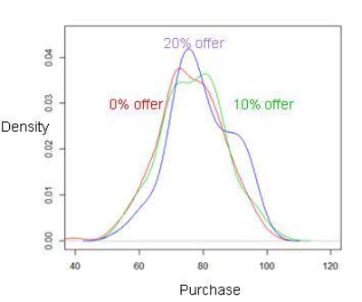
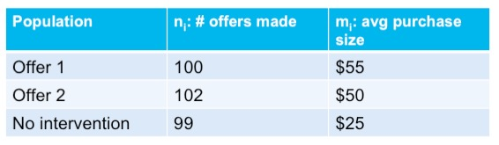
Analysis of variance (ANOVA)
ANOVA is a generalization of the difference of means
Test the equality of means of k populations
Useful in experiments where the levels of one or more factors are adjusted
Example: determine the effect of discount on average purchase amount

Slide 4
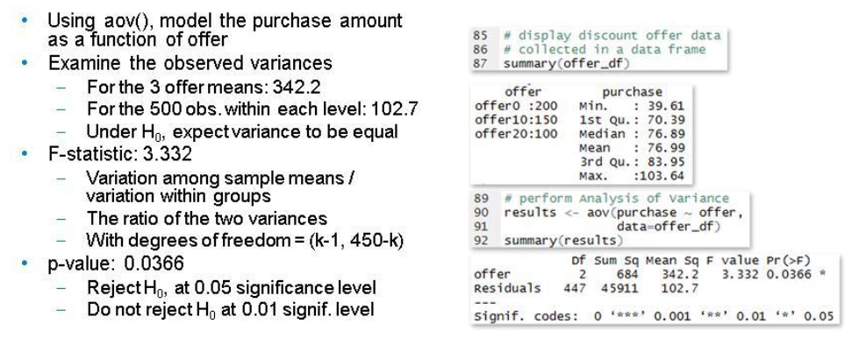
ANOVA in R

Slide 5
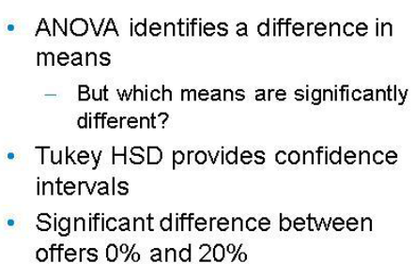
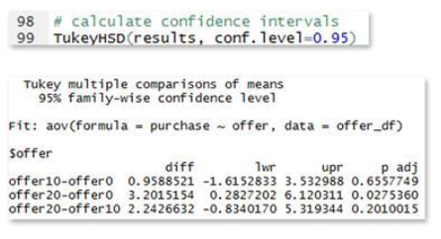
Tukey honest significant differences

Slide 6
Type I and Type II Error

Slide 7
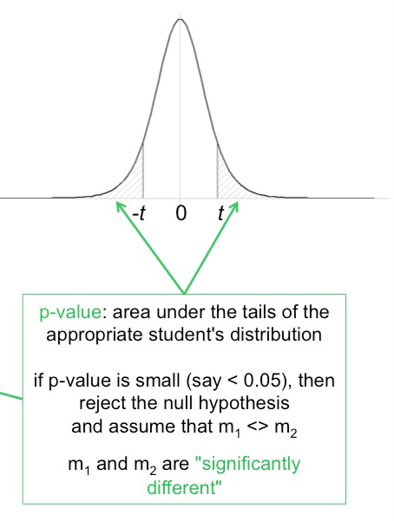
Review: p-Values
A p-value (observed significance level) is the probability of obtaining a test statistic value equal to or more extreme than that obtained from the sample data when the null hypothesis is true.
Reject H₀ if the p-value < α

Slide 8
Understanding Potential Errors in Hypothesis Testing
Hypothesis testing can result in one of four different outcomes:
1. H₀ is true and the test correctly fails to reject H₀
2. H₀ is false and the test correctly rejects H₀
3. H₀ is true and the test incorrectly rejects H₀ (called Type I error)
4. H₀ is false and the test incorrectly fails to reject H₀ (called Type II error)

Slide 9
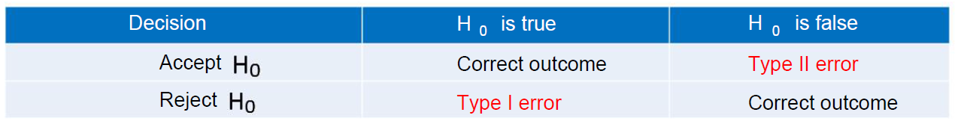
Possible errors in hypothesis testing
Analyst controls the likelihood of committing a Type I error.
Set the significance level, α, to a small enough value
If H₀ is true, the analyst will only reject H₀ with probability α
Analyst influences the likelihood of committing a Type II error.
Probability, β, of committing a Type II error depends on the significance level, α
Choose a large enough sample size to detect a specified effect size

Slide 10
Example: Information Security System
 | Authorized User (H₀ is true, H₁ is false) | Unauthorized User (H₀ is false, H₁ is true)
Give Access (accept H₀) | Give access to authorized users | Give access to unauthorized users (Type II error)
Deny Access (accept H₁) | Deny authorized users’ access request (Type I error) | Deny unauthorized users’ access request

Slide 11
Significance and Power
Significance: the probability of wrongly rejecting the null hypothesis; the probability of false positive (α)
p-value is your significance
Power: the probability of correctly rejecting the null hypothesis; the probability of a true positive (1-β)

